Slide 1
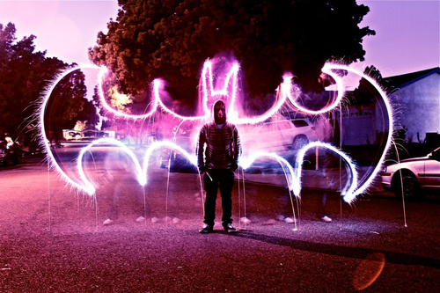
1
Notes:
Bron: http://www.neatorama.com/tag/light-graffiti/

Slide 2
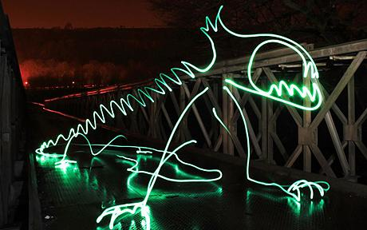
2
Notes:
Bron: https://lollitop.blogspot.com/2009/04/light-graffiti-michael-bo_11.html

Slide 3
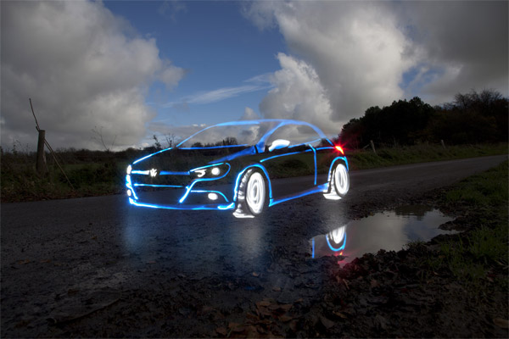
3
Notes:
Bron: http://newgraffitiletters.blogspot.com/2010/12/graffiti-light-amazing-and-interesting.html

Slide 4
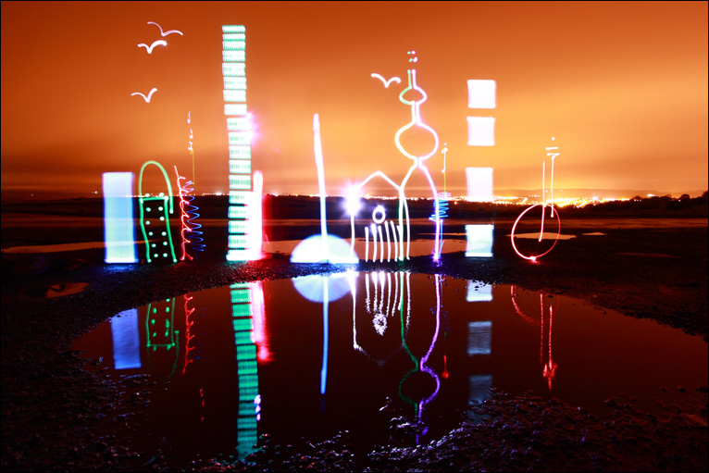
4
Notes:
Bron: http://internetsecuritysoftware.info/bari/l/light-graffiti-city/

Slide 5
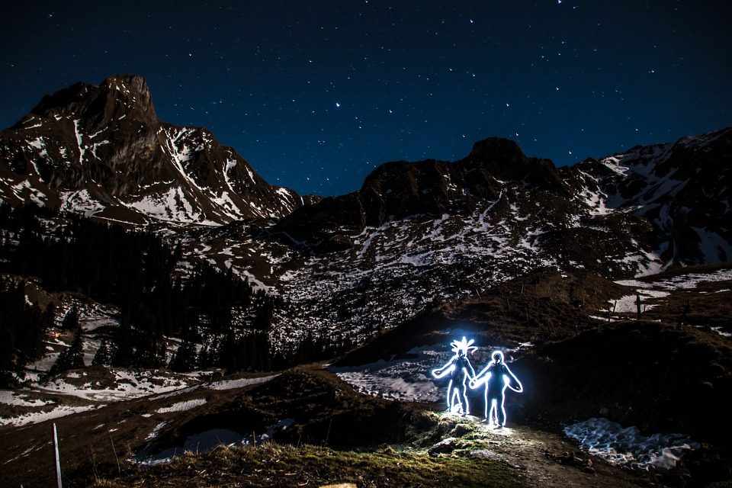
5
Notes:
Bron: https://musikkabine.de/die-neue-gesangshook-tonight-von-hiltrop-ist-jetzt-online-2/

Slide 6

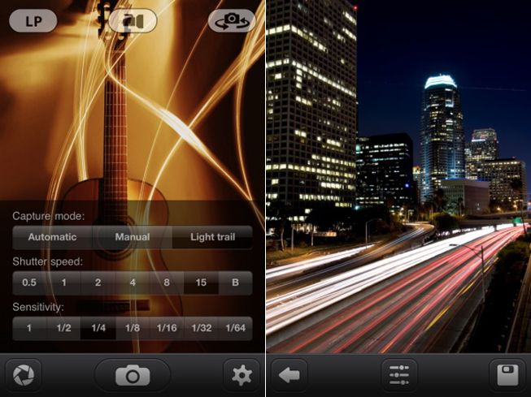

Slide 7
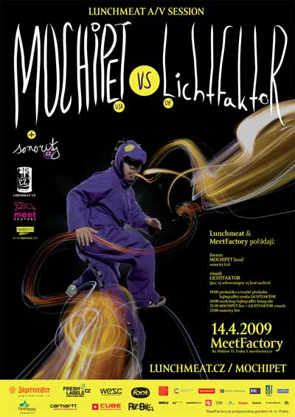
Notes:
Bron: https://www.lichtfaktor.com/en/

Slide 8
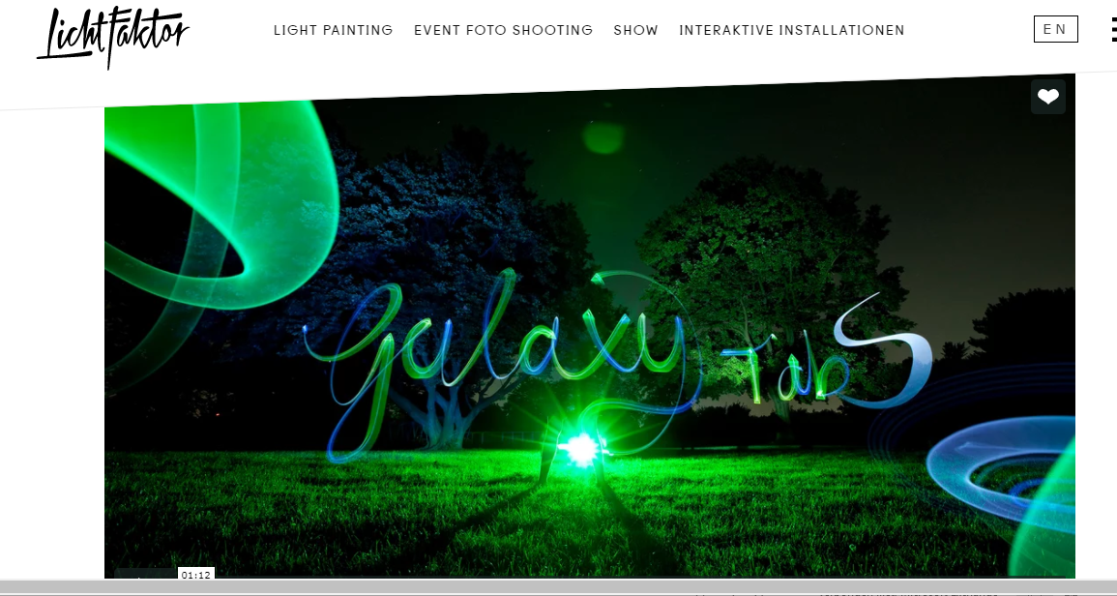
Notes:
Bron: https://www.lichtfaktor.com/en/

